Slide 1
DIV (Divide)
Instructions

Slide 2
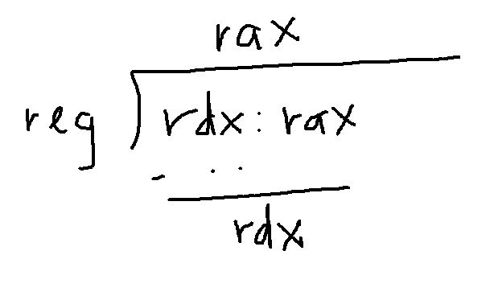
Example of DIV (dword reg)
rax ← rdx:rax / register
rdx ← rdx:rax % register
Quotient
Remainder

Slide 3
Exceptions
division by 0
  eg mov rax, 0x3
  mov rdx, 0x0
  mov rcx, 0x0
  div ecx
quotient overflow – if quotient is too large
  eg mov rax, 0xFFFFFFFFFFFFFFFF
  mov rdx, 0xFFFFFFFFFFFFFFFF
  mov rcx, 0x2
  div rcx

